Slide 1
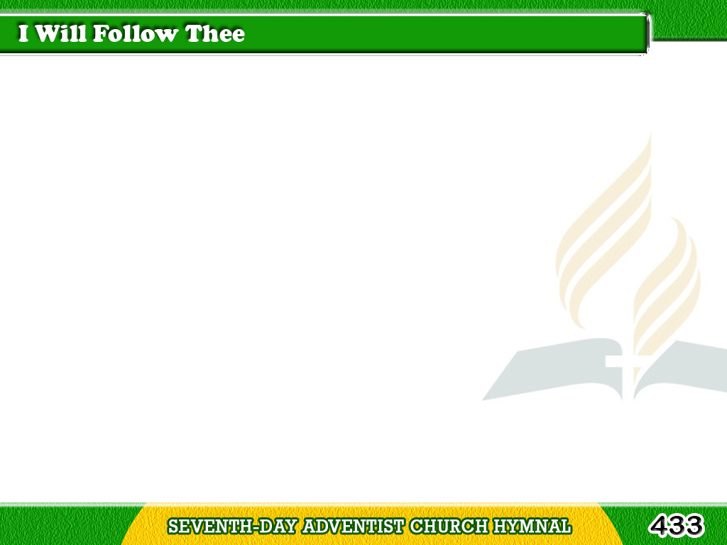
1/5
I will follow Thee, my Savior,
Where soe’er my lot may be.
Where Thou goest I will follow;
Yes, my Lord, I’ll follow Thee.
Tagalog
Version

Slide 2
1/5
I will follow Thee, my Savior,
Thou didst shed
Thy blood for me;
Tagalog
Version

Slide 3
1/5
And though all men
should forsake Thee,
By Thy grace I’ll follow Thee.
Tagalog
Version

Slide 4
2/5
Though the road
be rough and thorny,
Trackless as the foaming sea,
Tagalog
Version

Slide 5
2/5
Thou hast trod
this way before me,
And I’ll gladly follow Thee.
Tagalog
Version

Slide 6
2/5
I will follow Thee, my Savior,
Thou didst shed
Thy blood for me;
Tagalog
Version

Slide 7
2/5
And though all men
should forsake Thee,
By Thy grace I’ll follow Thee.
Tagalog
Version

Slide 8
3/5
Though I meet with tribulations,
Sorely tempted though I be;
I remember Thou wast tempted,
And rejoice to follow Thee.
Tagalog
Version

Slide 9
3/5
I will follow Thee, my Savior,
Thou didst shed
Thy blood for me;
Tagalog
Version

Slide 10
3/5
And though all men
should forsake Thee,
By Thy grace I’ll follow Thee.
Tagalog
Version

Slide 11
4/5
Though Thou leadest me
through affliction,
Poor, forsaken though I be;
Thou wast destitute, afflicted,
And I only follow Thee.
Tagalog
Version

Slide 12
4/5
I will follow Thee, my Savior,
Thou didst shed
Thy blood for me;
Tagalog
Version

Slide 13
4/5
And though all men
should forsake Thee,
By Thy grace I’ll follow Thee.
Tagalog
Version

Slide 14
5/5
Though to Jordan’s
rolling billows,
Cold and deep,
Thou leadest me,
Tagalog
Version

Slide 15
5/5
Thou hast crossed
the waves before me,
And I still will follow Thee.
Tagalog
Version

Slide 16
5/5
I will follow Thee, my Savior,
Thou didst shed
Thy blood for me;
Tagalog
Version

Slide 17
5/5
And though all men
should forsake Thee,
By Thy grace I’ll follow Thee.
Tagalog
Version

